Slide 1



किसान रथ
Kisan Rath
Operational Guidelines

Slide 2

Contents
Registration
  Farmers
  Traders
  Service Providers
Sign-In
  Sign-In
  Change Password
  Forgot Password
Farmer / Trader related functionalities
  Post a Load
  View posted load requests
  View responses to posted load
Service Provider related functionalities
  Onboard Vehicle
  View Load Requests Posted by Farmers/Traders
  Accept a Load / Contact the Requester for more info

Slide 3
1. Registration

Slide 4
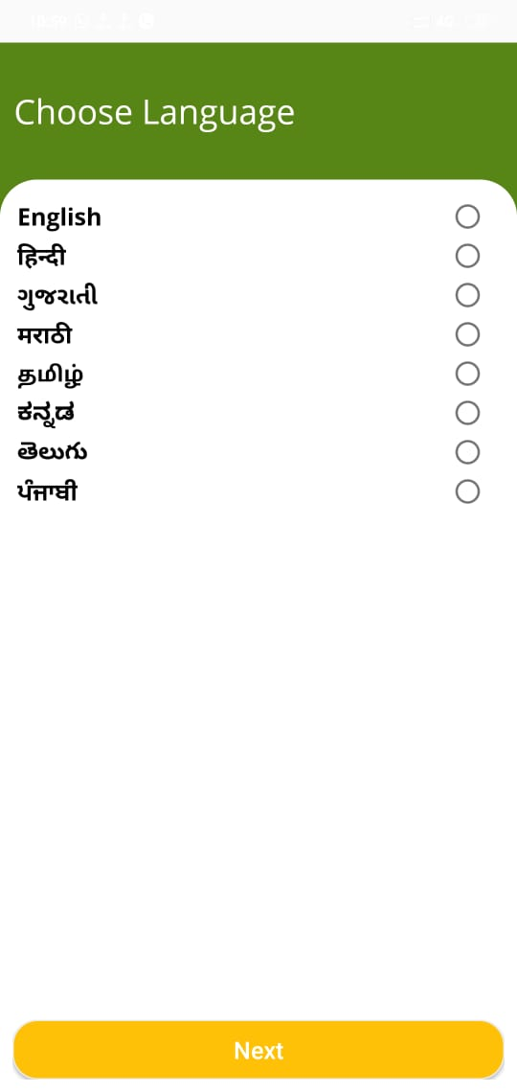
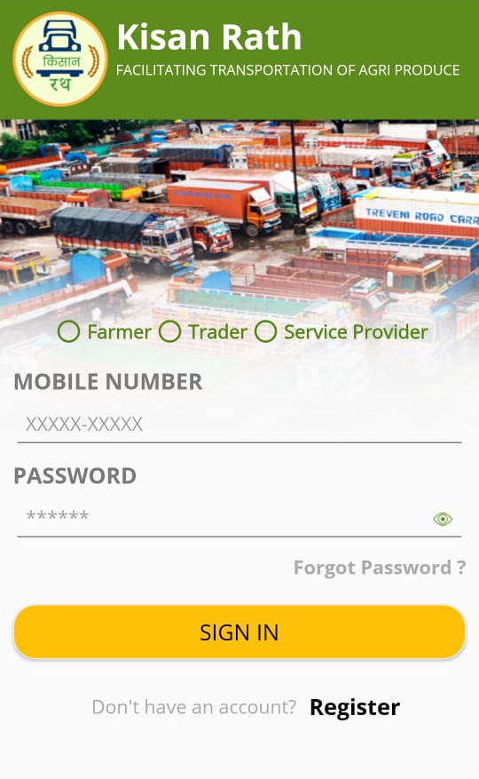
Registration
1. Select your preferred language
2. Click on “Register”

Slide 5
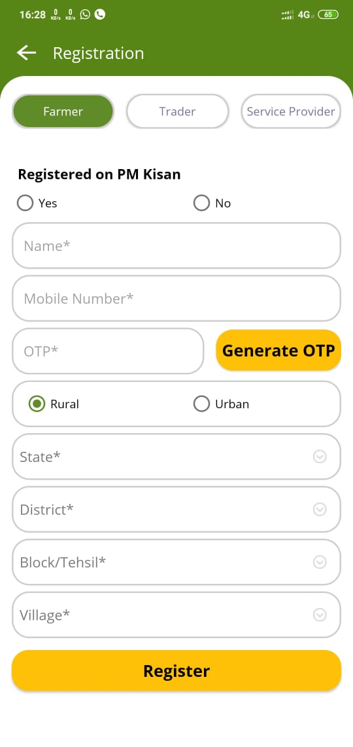
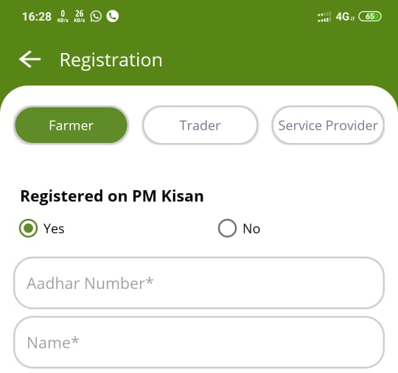
Registration - Farmers
2. After entering the mobile number, click on “Generate OTP”. The OTP will be sent to your mobile via SMS.
3b. Fill in the OTP received for verification of mobile number
1. Select Farmer as your Role and fill in the required fields.
PM-KISAN beneficiaries to select “Registered on PM-KISAN” and enter Aadhaar number along with other details.
3. After filling all the required fields, click on “Register” to proceed.

Slide 6
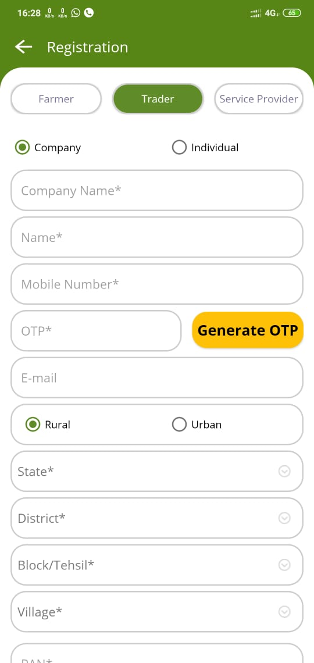
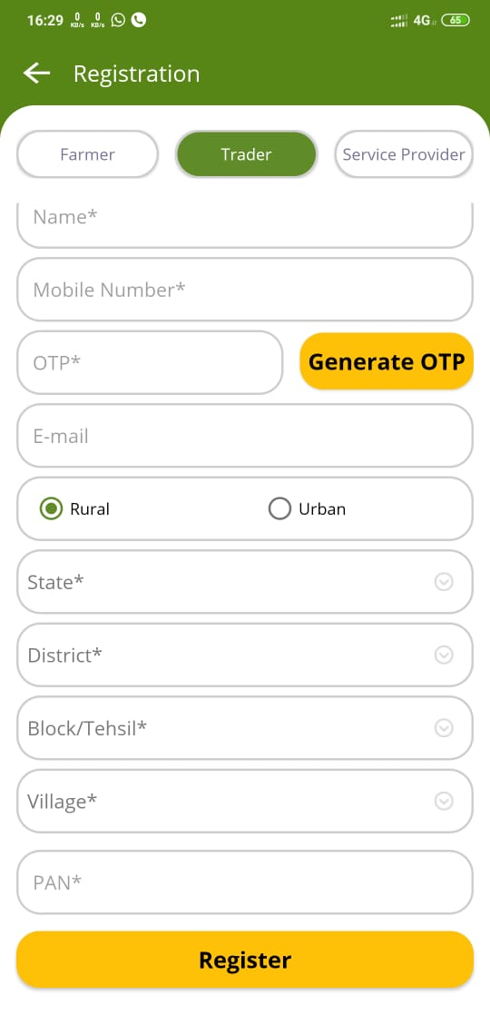
Registration - Traders
2. After entering the mobile number, click on “Generate OTP”. The OTP will be sent to your mobile via SMS.
3b. Fill in the OTP received for verification of mobile number
1. Select “Trader” as your Role and fill in the required fields.
The Trader shall select if he is an individual or an Company. For Companies, the Company name shall also be entered
3. After filling all the required fields, click on “Register” to proceed.

Slide 7
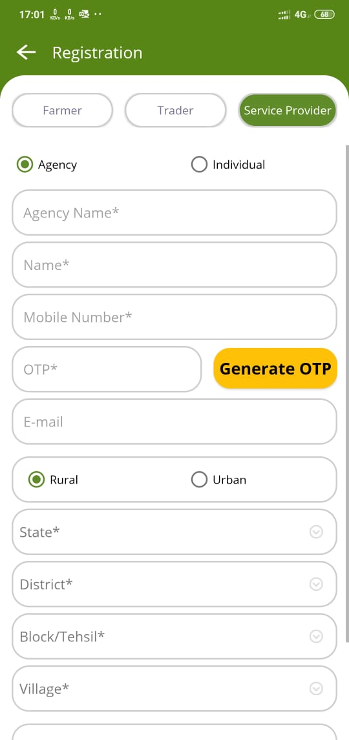
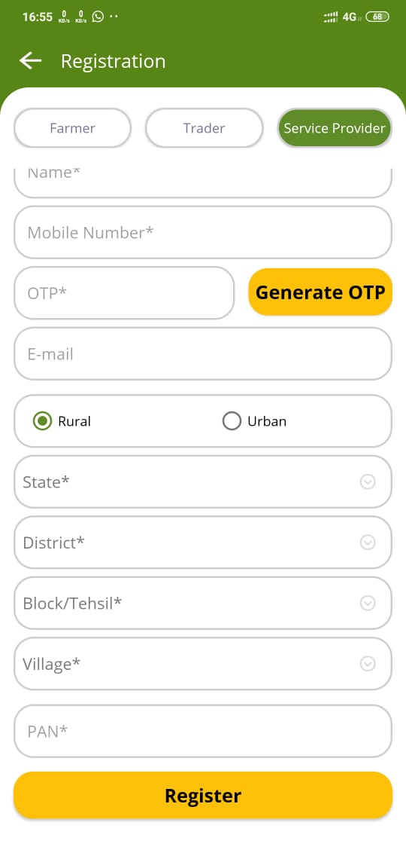
Registration – Service Provider
2. After entering the mobile number, click on “Generate OTP”. The OTP will be sent to your mobile via SMS.
3. Fill in the OTP received for verification of mobile number
1. Select your Role and fill in the required fields.
The Service Provider shall select if he is an individual or a transport agency.
For Agencies, the Agency name & PAN no. shall also be entered
4. After filling all the required fields, click on “Register” to proceed.

Slide 8
2. Sign-In

Slide 9
Sign-In
1. Select your user role (Farmer/Trader/Service Provider)
2. Enter your registered mobile number and Password
3. Click on “Sign-In”

Slide 10
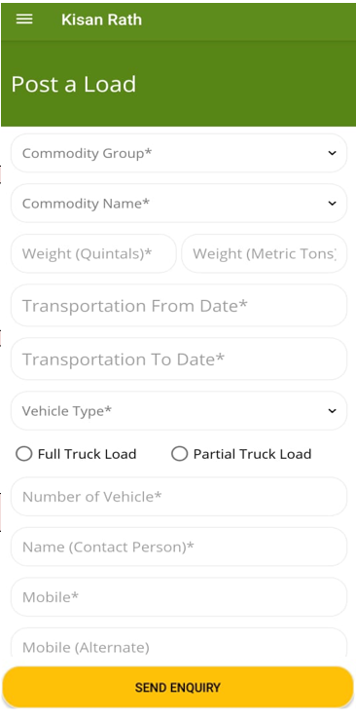
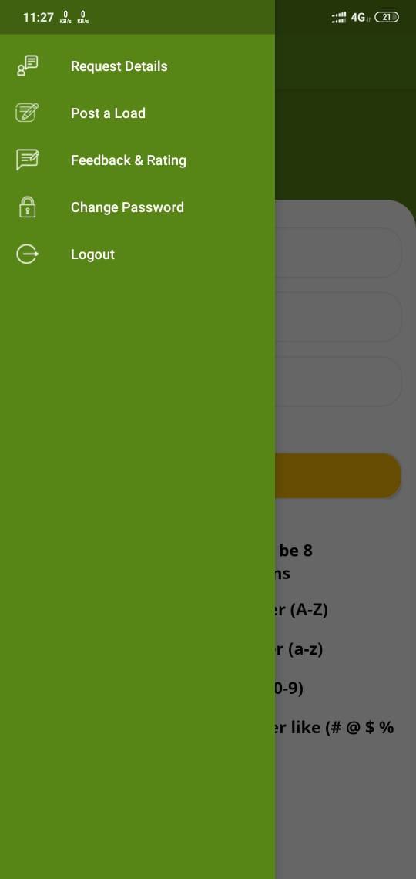
Change Password
1. If you wish to change the password, then, after signing-in, click on the top left three bars
2. Click on “Change Password”

Slide 11
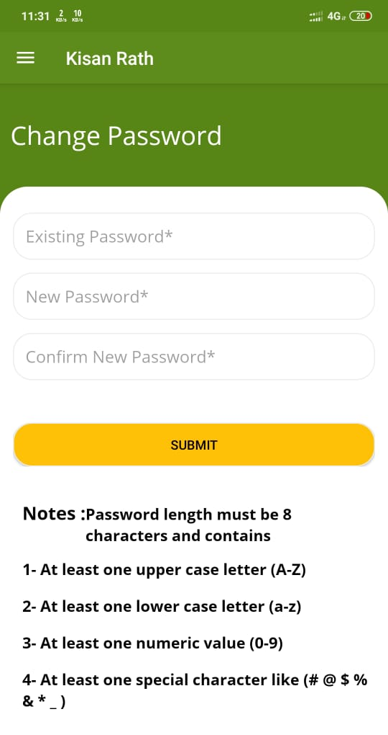
Change Password
1. Enter existing password
2. Enter New password as per the criteria mentioned on the screen
3. Re-enter New password
4. Click on “Submit”

Slide 12
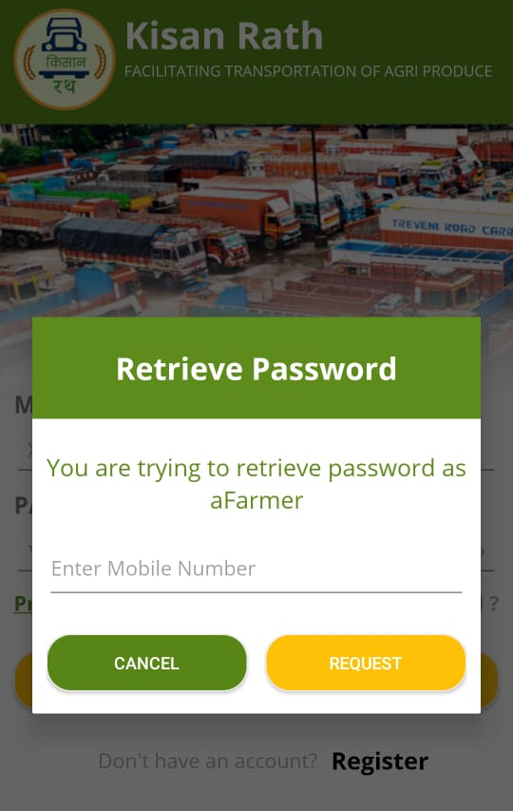
Forgot Password
1. If you have forgotten your password, select your user type
3. Enter your registered mobile number and click on “Request”.
Your password will be sent via SMS
2. Click on “Forgot Password”

Slide 13
3. Farmer / Trader Functions

Slide 14
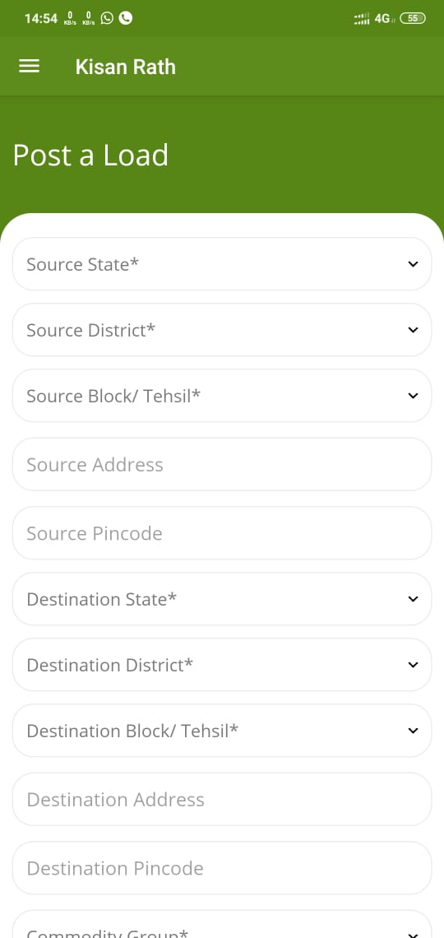
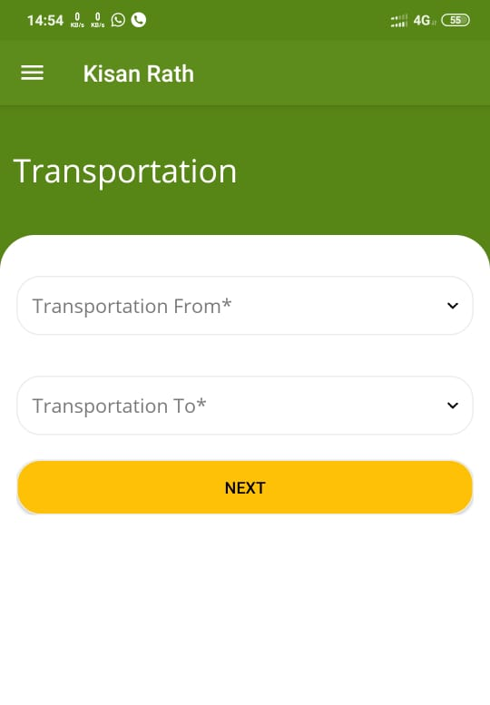
Post a Load
2. Fill in the source and destination details.
1. Select if the transport is required from / to Farm, Mandi or Warehouse and click on “Next”
…contd.

Slide 15
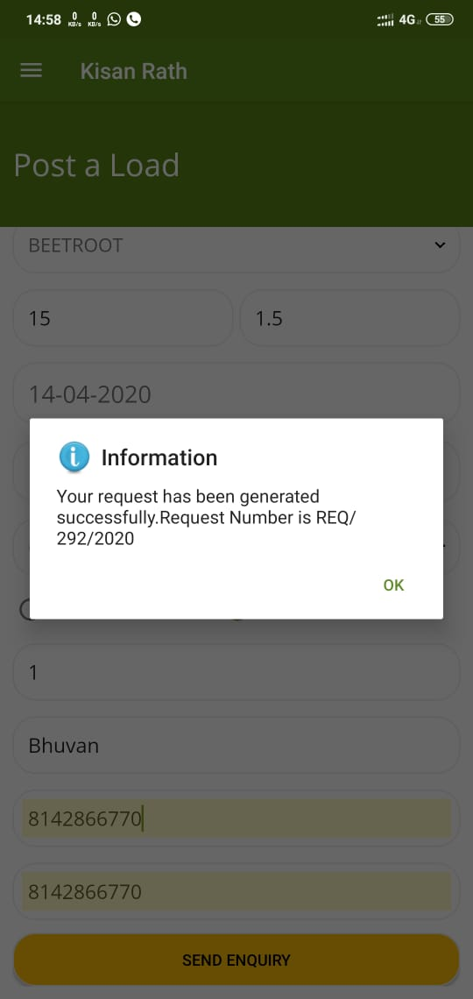
Post a Load…contd.
3. Select the commodity group, commodity name, and enter weight in quintals
4. Enter the range of dates between which the despatch can take place, and select the vehicle type
5. Select if you want a full truck load or a partial truck load. Enter the number of vehicles required for full truck load.
6. Fill in the name and number of contact person and click on “Send Enquiry”

Slide 16
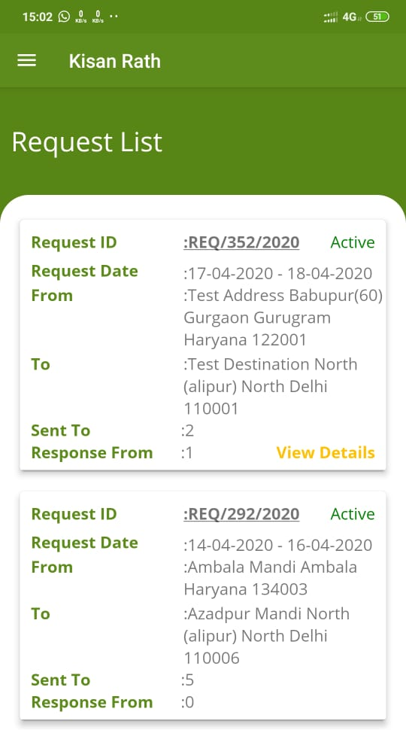
View posted load requests
1. Click on the three bars on top left corner, and select “Request Detail” from the pop-up menu
3. Click on “View Details” to see the responses and contact the transporters
2. The no. of aggregators to whom the request is sent and the no. of responses received can be seen

Slide 17
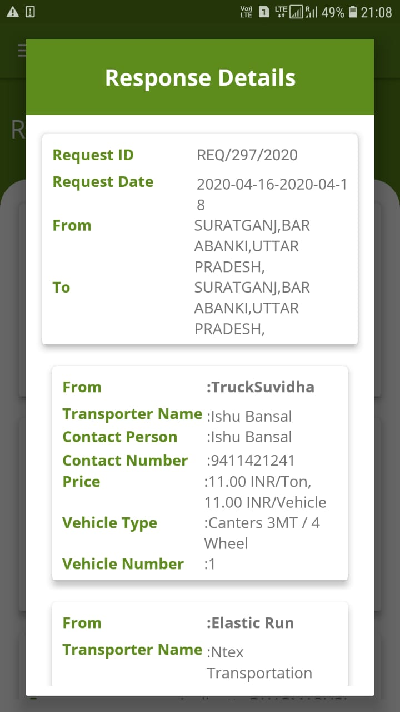
View responses to posted load
1. The responses from transporters containing the quote, vehicle type and contact numbers are displayed for the load request.
2. In case of more than one response, the user can scroll through the page to see all responses and contact his preferred transporter.

Slide 18
4. Service Provider

Slide 19
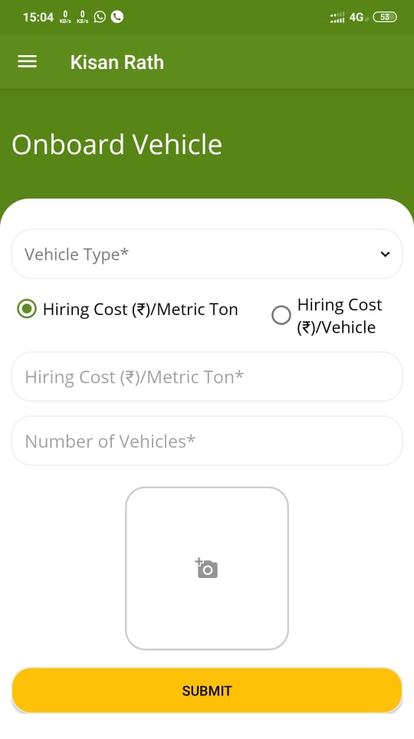
Onboard Vehicle
1. Select the vehicle type.
2. Select your preferred type of hiring cost (Per ton / Per vehicle)
3. Enter the hiring cost
4. Enter the number of vehicles and upload the photo
5. Click on “Submit” after entering all the details

Slide 20
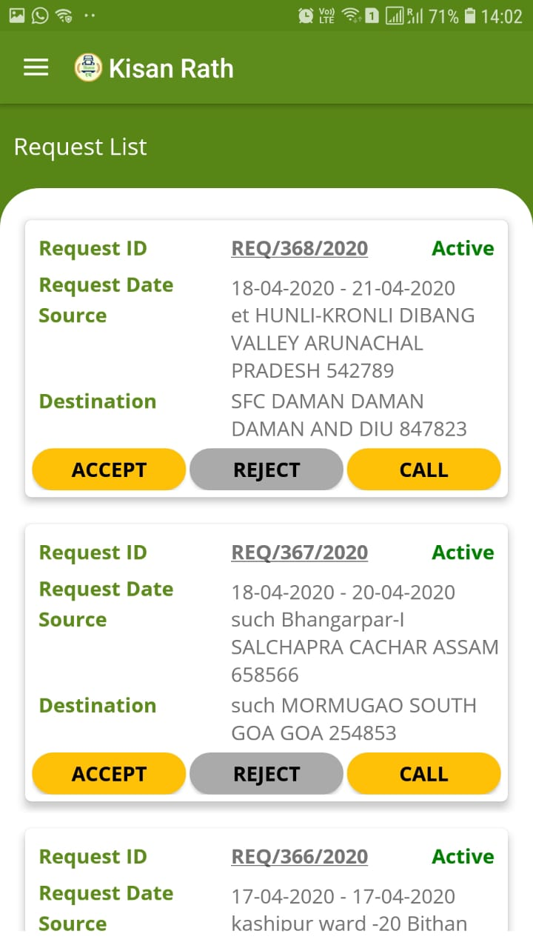
View Posted Loads
All the loads posted by farmers or traders shall be displayed in service provider’s home screen.
The service provider can accept or reject the load request as per his availability.
Service Provider can also call the farmer / trader on their given mobile number for any clarification or discussion.

Slide 21
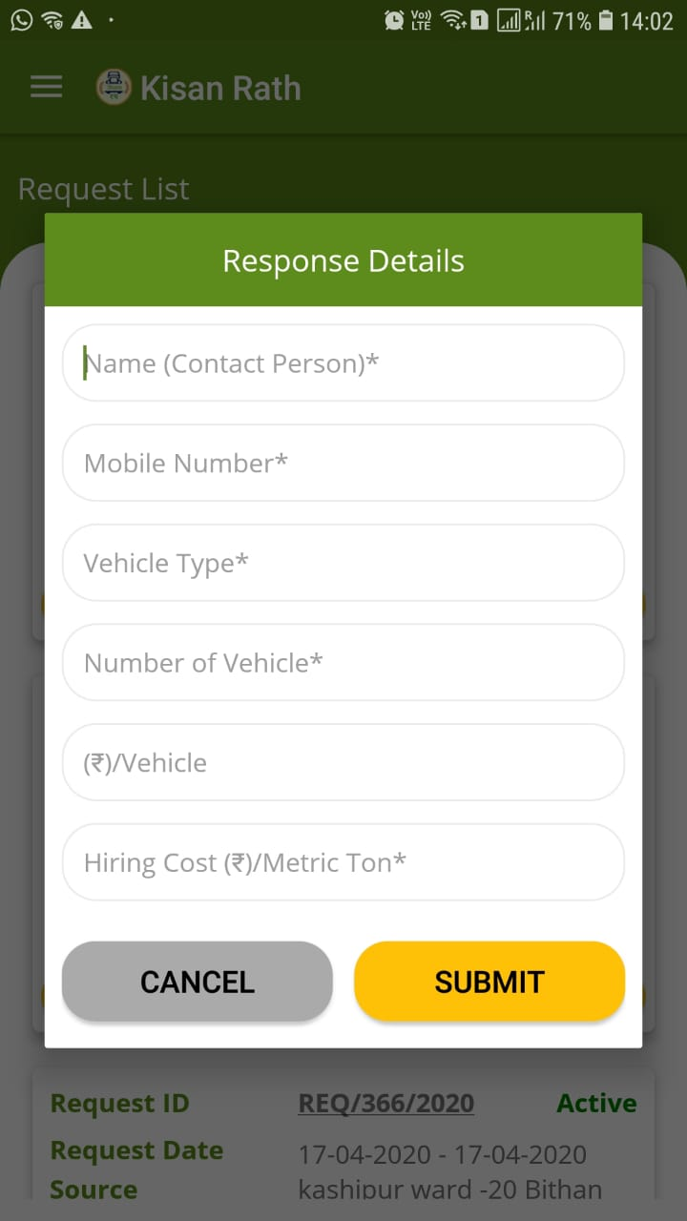
Accept a Load
1. Once the transporter clicks on “Accept”, a pop-up window opens for entering the details of response.
2. Enter the following details:
Name of Contact person
Mobile number of contact person
Vehicle type
Number of vehicles
Cost per vehicle
Cost per metric ton.
3. Click on “Submit”.
Now the response would be visible in Farmer’s screen.

Slide 22
Thank You

